Slide 1
High Performance Scientific Computing
SOMNATH ROY
MECHANICAL ENGINEERING DEPARTMENT, IIT KHARAGPUR
Module : GPU Computing
Lecture : Matrix multiplications in CUDA

Slide 2
CONCEPTS COVERED
Thread and block id- pointer to main data
Matrix-vector product
Matrix-matrix product
Tiling and shared memory

Slide 3
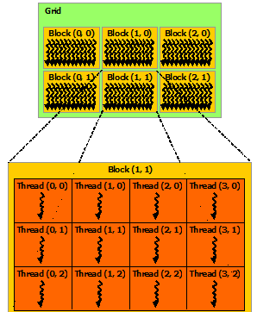
Blocks and threads
Threads are organized in blocks of the grid.
Kernel launches all threads in a grid following an SIMT model.
The kernel function is executed as gridsize x blocksize number of times in that many threads
Blocksize and gridsize information is available in the execution configuration myKernel<<<gridsize, blocksize>>>(...)
The variables gridsize and blocksize are of type dim3 and can have three-dimenstions
Block dimension (number of threads in each dimension in a box) is given as: blockDimx.x, blockDimx.y, blockDimx.z
id of a given block in the grid is given as: blockIdx.x, blockIdx.y & blockidx.z
Local thread id (within a block) is given as threadIdx.x, threadIdx.y & threadIdx.z
It might be important to find global thread id for some problems
Source:
NVIDIA CUDA programming guide

Slide 4
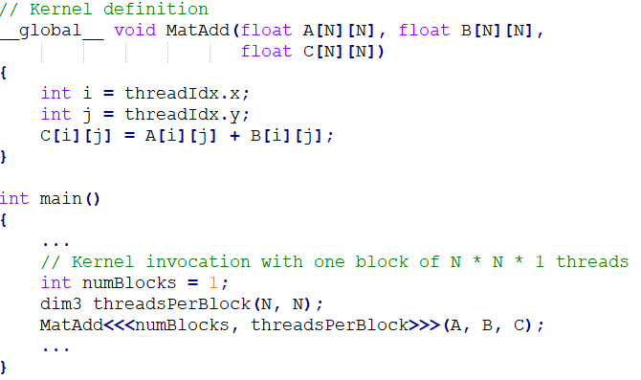
Blocks and threads (cont.)
In the example problem of matrix addition, 2D thread id-s are used as pointers to matrix elements in the kernel function
x id of the thread points to matrix row
y id of the thread points to matrix column
thread id is used to point to the memory location which
will be accessed by the particular thread
A single block is launched in the grid. So, local thread id is same as the global thread id and points to the location of the matrix column and row

Slide 5
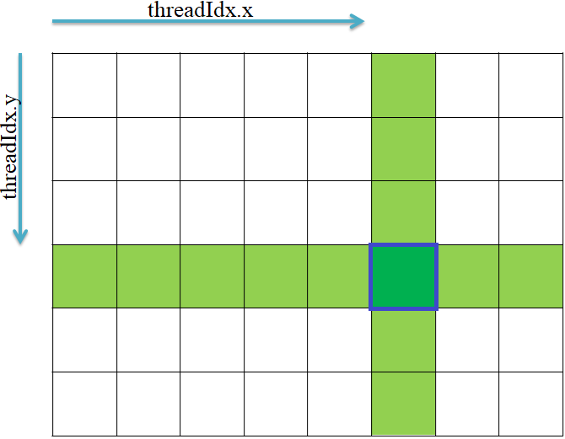
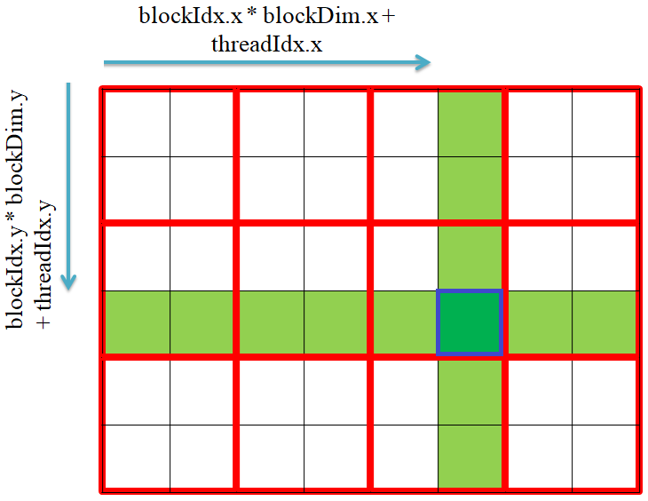
Pointing matrix memory location
If the gridsize is (1,1,1) [single block]
For a general two-dimensional grid:
Global id of the thread is obtained from the local thread id, local block id and blocksize.
Courtesy: HBeonGpgpu https://pccsgpgpu.webs.com

Slide 6
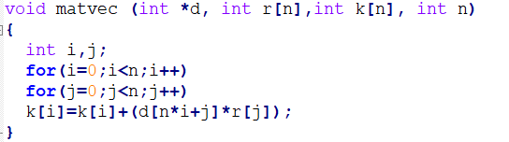
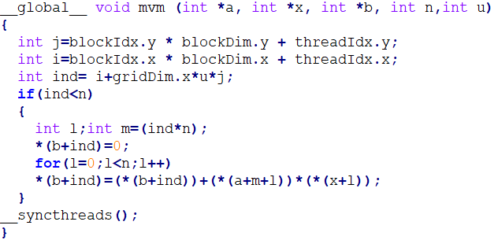
Matrix-vector multiplication using CUDA
Serial subroutine:
For a 1280X1280 matrix, serial execution in Xeon E5-2620 v4 CPU takes 0.447904 s
P100 GPU (12 GB) takes 0.384960 s
Put the matrix in a one-d array for coalesced access
CUDA kernel:
blocksize = uxu
A coalesced global memory access pattern is followed
Courtesy: Mr. Dilip Subbaian G

Slide 7
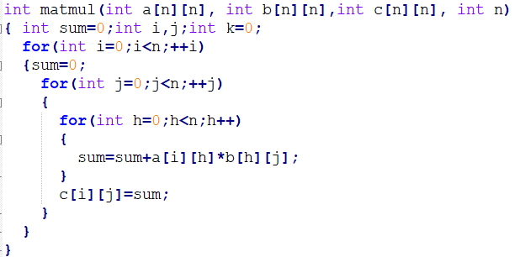
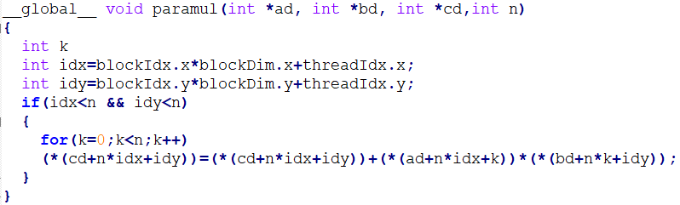
Matrix-matrix product
CPU function
Observations:
Large number of memory access
Cache unfriendly access of bd
Shared memory and tiling can help
CUDA kernel

Slide 8
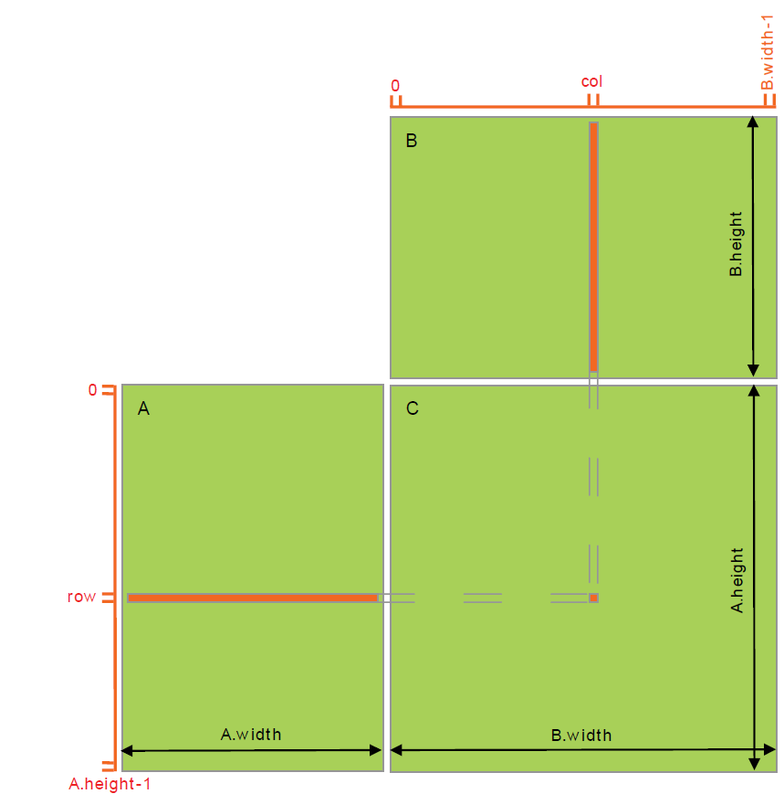
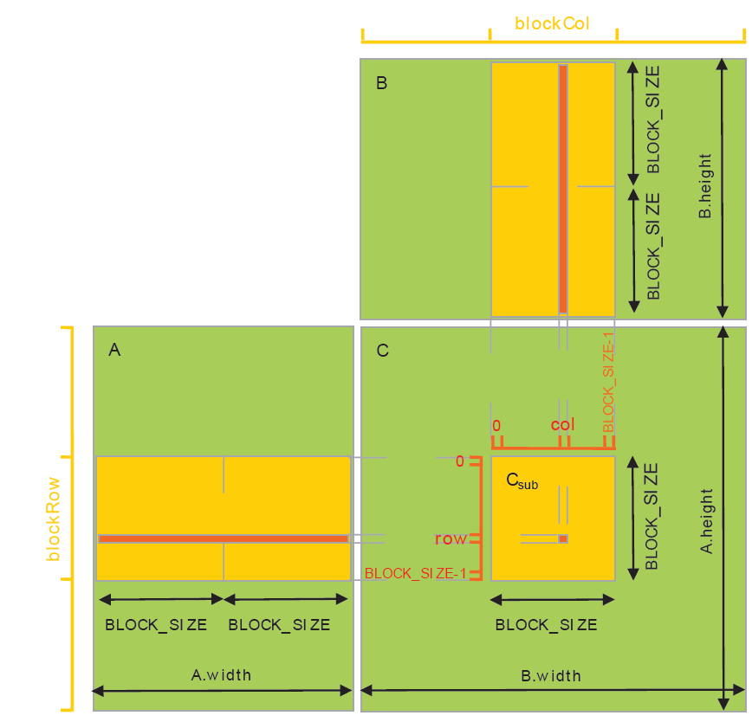
Matrix-matrix product – tiling and shared memory usage
Source: NVIDA CUDA Programming Guide
simple matrix multiplication
matrix multiplication with tiling tile size matches with block size and fits shared memory

Slide 9
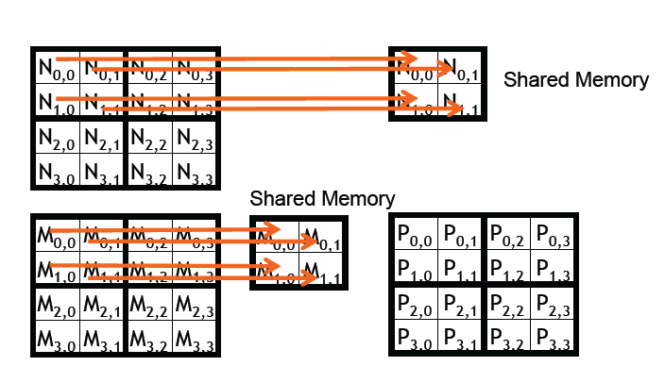
Matrix-matrix product – tiling and shared memory (cont)
Source: GPU teaching kit, NVIDIA-UIUC

Slide 10
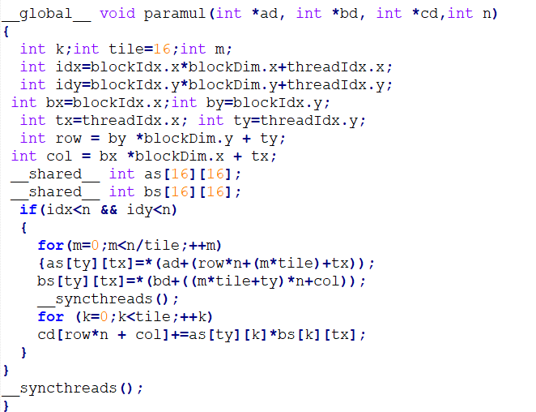
Matrix-matrix product – tiling and shared memory optimized
Non coalesced [2d array] used for shared memory as the memory size is small, bandwidth is high
For 1280 x 1280 matrix
Sequential code takes 214.9249 sec
Optimized CUDA code takes 6.3870 sec

Slide 11
Matrix solvers- performance
In Conjugate gradient or Biconjugate gradient matrix solvers, matrix-vector products are expensive and they are parallelized by calling CUDA kernels.
The performance results (using P100) are:
size | CUDA | serial
5000 | 0.79 | 19.95
10000 | 1.96 | 134.91
20000 | 7.17 | 668.8
30000 | 29.08 | 1844.44
40000 | 45.77 | 4259.42
size | BiCGstab serial | Jacobi serial | BiCGstab CUDA | Jacobi CUDA
144 | 0.021 | 0.029 | 0.019 | 0.066
3310 | 27.91 | 792.74 | 0.62 | 18.01
7705 | 125.4 | 9482.46 | 4.25 | 187.24
Conjugate gradient solver for symmetric matrix, size as no. of rows, time in seconds
Different matrix solvers for non-symmetric unstructured matrix, size as no. of rows, time in seconds
GPU codes give better speed-up for larger matrices

Slide 12
REFERENCES
https://docs.nvidia.com/cuda/cuda-c-programming-guide/index.html
https://docs.nvidia.com/cuda/cuda-c-best-practices-guide/index.html

Slide 13
CONCLUSION
Basic thread algebra for vector and matrix operations showed
Parallelization of matrix products discussed
Performance of parallel matrix solvers presented

